Slide 1
CYBR 463/563 Applied Cryptography
Winter 2026

Slide 2
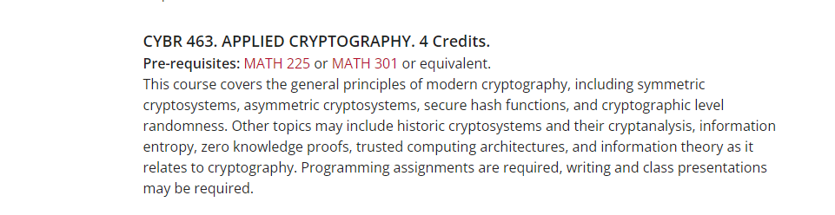
Catalog Description and Link
Cybersecurity (CYBR) < Eastern Washington University

Slide 3
Canvas
CYBR 463-040: Applied Cryptography

Slide 4
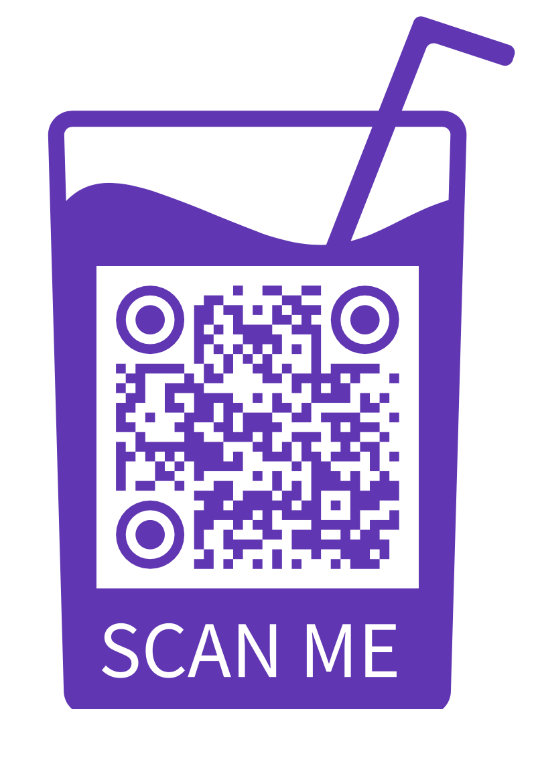
Lets Know Each Other

Slide 5
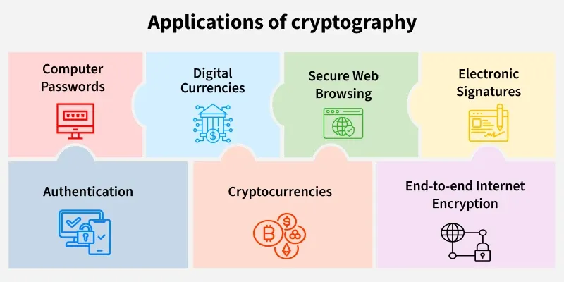

Slide 6
Applications and Cryptographic Algorithms
Application | Security Goals | Cryptographic Algorithms Used
Secure Messaging (WhatsApp, Signal) | Confidentiality, Integrity, Authentication | AES-256, ECC (Curve25519), SHA-256, HMAC
Secure Web (HTTPS / TLS) | Confidentiality, Integrity, Authentication | AES-128/256, RSA, ECDHE, SHA-256
Blockchain (Bitcoin) | Integrity, Authentication, Non-Repudiation | SHA-256, ECDSA
Wi-Fi Security (WPA2 / WPA3) | Confidentiality, Integrity | AES-CCMP, SAE, SHA-256
Cloud Services | Confidentiality, Integrity | AES-256, TLS, HMAC
Secure Email (PGP / S-MIME) | Confidentiality, Authentication | RSA / ECC, AES, SHA-256

Slide 7
Quiz Time

